Slide 1
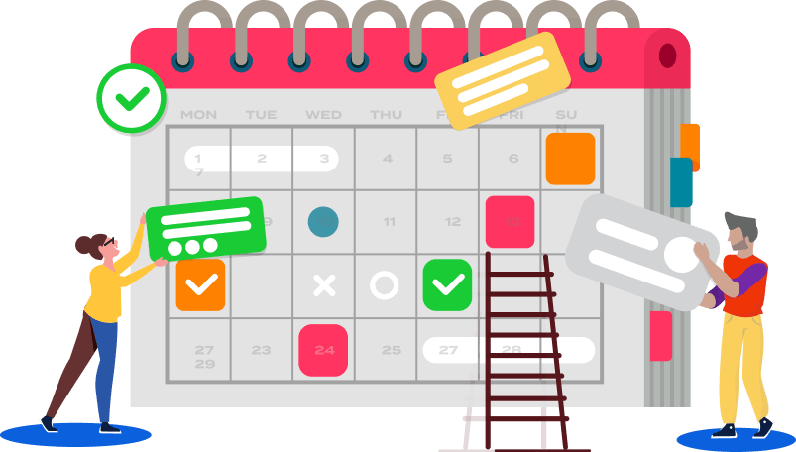

Simple Life Organizer
Noah King

Slide 2

Key Features
1. Task Management
- Effortlessly add, categorize, and track tasks with intuitive controls.
2. Appointment Scheduler
- Consolidate all your appointments in one easy-to-view calendar.
3. Reminders for Special Occasions
- Never miss important dates—get reminders for birthdays, anniversaries, and more.
4. Daily Affirmations and Quotes
- Start your day inspired with curated affirmations and motivational quotes.
5. Customizable Interface
- Personalize your experience with selectable themes, fonts, and layouts.

Slide 3
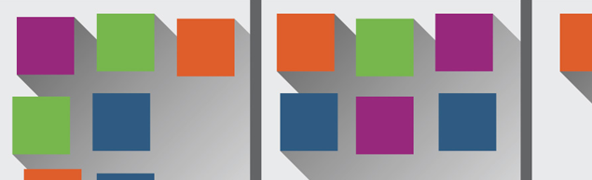

Why Choose Simple Life Organizer?
1. Simplicity at Its Core: Designed to be intuitive and user-friendly, our app eliminates complex setups and clutter, allowing you to organize your life with ease.
2. All-in-One Solution: Manage tasks, schedule appointments, and set reminders all from one streamlined platform. Everything you need, simplified.
3. Personal Touch: Customize themes, fonts, and layouts to match your style and preferences, making planning an enjoyable experience.
4. Built-In Motivation: Start your day positively with daily motivational quotes and affirmations, directly integrated into your routine.

Slide 4
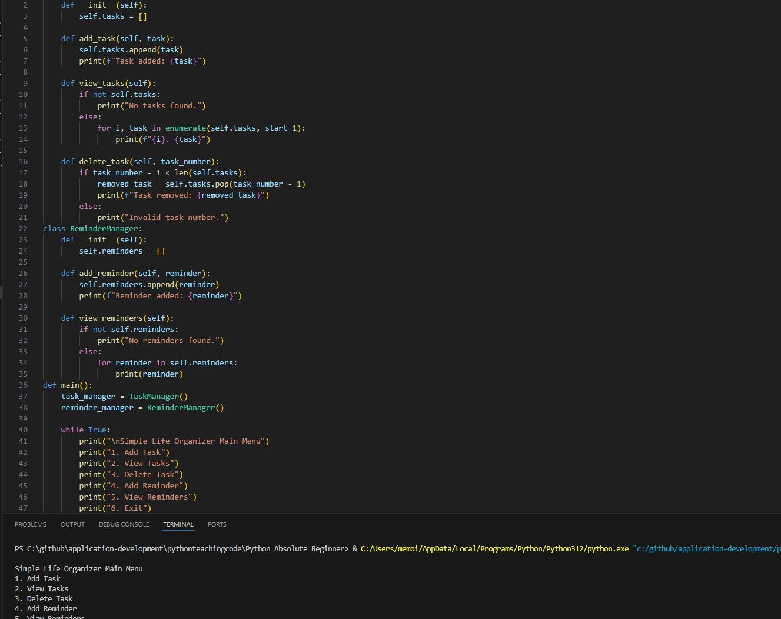

Step 1
Run Code

Slide 5
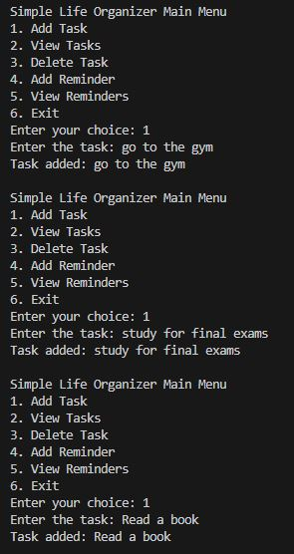

Step 2
Once you have run the code, start by adding what you would like to add to your calendar.

Slide 6
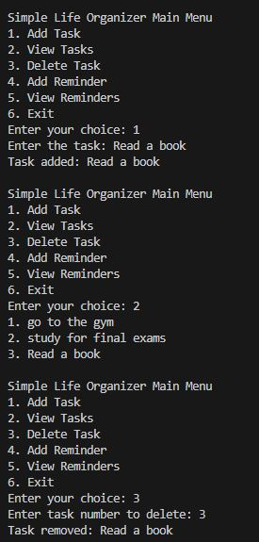
Step 3
After seamlessly adding your tasks, the Simple Life Organizer lets you effortlessly view and arrange your agenda to perfectly align with your daily priorities.

Slide 7
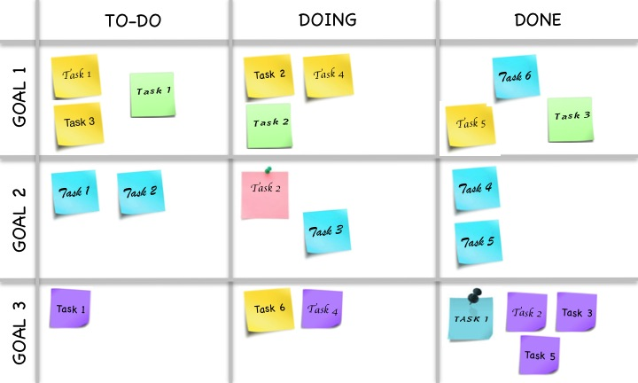
Future Directions
In the future I would like to develop a mobile version, add cloud synchronization, and expand the reminder system to incorporate learning algorithms for personalized notification timing

